Slide 1

Sentiment Analysis of Customer Feedback on Restaurants
By Shyamkrishnan Sudhir

Slide 2

Purpose
To get the detail opinion or sentiments, we have to process the document to aspect level. Aspect level sentiment analysis is to determine the features of the sentiment conveyed towards each aspect and the given target entities.

Slide 3
Existing Work
Traditional approaches on sentiment analysis use word count or frequencies in the text which are assigned sentiment value by expert. These approaches disregard the order of words. Scientists are actively researching sentiment analysis that has become the biggest area of research in the last few years.

Slide 4


Proposed Solution
We used supervised and rule based techniques to mine the opinions from online product reviews. The approach which is used in this paper has five stages.
These stages are acquiring dataset through various visualization, data preprocessing, extraction of features implementing the machine learning classifiers through Keras and Anaconda, and lastly, evaluated models through train test split by using different metrics of binary classification.

Slide 5
Now let us have a look at
The Block Diagram of our solution and approach

Slide 6

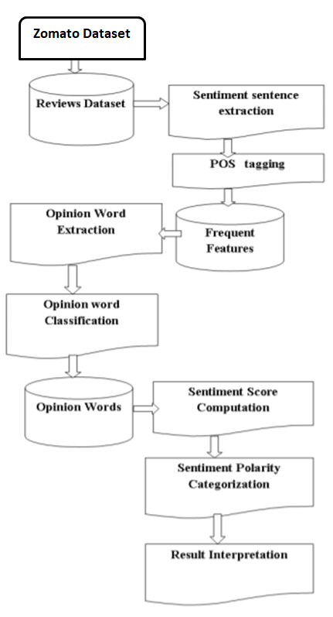

Slide 7
Experimental
Investigations

Slide 8
The steps are:
Data Collection
Sentiment Sentence Extraction and POS Tagging
Negative Phrase Extraction

Slide 9
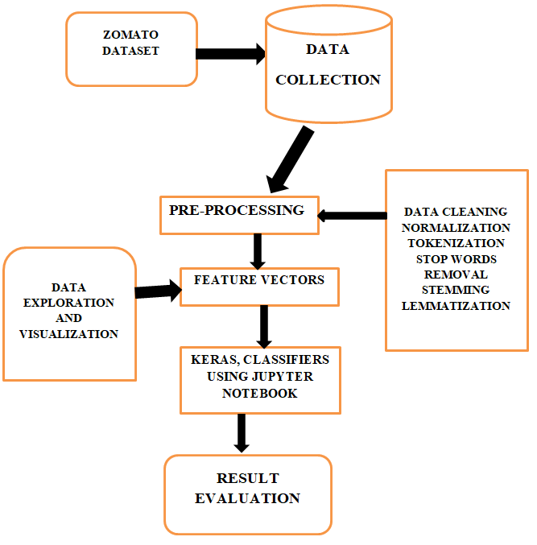
FLOW CHART

Slide 10
APPLICATIONS

Slide 11
PRODUCT ANALYSIS
Find out what the public is saying about a new product right after launch, or analyze years of feedback you may have never seen.
You can search keywords for a particular product feature (interface, UX, functionality) and use aspect-based sentiment analysis to find only the information you need.
Discover how a product is perceived by your target audience, which elements of your product need to be improved, and know what will make your most valuable customers happy. All with sentiment analysis.

Slide 12
MARKET AND
COMPETITOR RESEARCH
Use sentiment analysis for market and competitor research. Find out who’s receiving positive mentions among your competitors, and how your marketing efforts compare.
Analyze the positive language your competitors are using to speak to their customers and weave some of this language into your own brand messaging and tone of voice guide.

Slide 13
WEB.PY

Slide 14

@app.route('/')
def welcome():
return render_template('home.html')
@app.route('/prediction', methods=['GET','POST'])
def pred():
if request.method == 'POST':
review = request.form['message']
review = re.sub('[^a-zA-Z]',' ',review)
review = review.lower()
review = review.split()
review = [ps.stem(word) for word in review if not word in set(stopwords.words('english'))]
review = " ".join(review)
review = cv.transform([review]).toarray()
y_p = model.predict(review)
if y_p.argmax() == 0:
output = "Average"
elif y_p.argmax() == 1:
output = "Good"
else:
output = "Poor"
return render_template('prediction.html',prediction = ("The Customer review is " + output))
else:
return render_template('prediction.html')
if __name__ == '__main__':
app.run(host = 'localhost', port=9000, debug=True, threaded=False)
import graphlib
import numpy as np
import pandas as pd
from flask import Flask, render_template, request
import tensorflow as tf
global graph
graph = tf.compat.v1.get_default_graph()
from keras.models import load_model
import pickle
import re
import nltk
nltk.download("stopwords")
from nltk.corpus import stopwords
from nltk.stem.porter import PorterStemmer
ps = PorterStemmer()
with open(r'cv.pkl','rb') as file:
cv = pickle.load(file)
model = load_model("zomato_2_analysis.h5",compile=False)
app = Flask(__name__,template_folder="templates")

Slide 15
SENTIMENT ANALYSIS.IPYNB

Slide 16
import numpy as np
import pandas as pd
dataset = pd.read_csv("zomato.csv")
data_review = dataset['reviews_list']
x = []
y = []
for row_num in range(51717):
lst = data_review[row_num].split("('")
for i in lst:
if len(i) > 5:
if i.find("',") != -1:
single_rev = i.split("',")
if len(single_rev[0]) > 2:
x.append(single_rev[0])
if len(single_rev[1]) > 2:
y.append(single_rev[1])
import nltk
nltk.download("stopwords")
from nltk.corpus import stopwords
from nltk.stem.porter import PorterStemmer
ps = PorterStemmer()
rating_final = []
review_final = []
import re
for loop in range(40000):
data_x = x[loop]
data_x = re.sub('[a-zA-Z]'," ",data_x)
data_x = data_x.split()
data_x = ''.join(data_x)
data_x = float(data_x)
if data_x < 2.5:
rating_final.append("poor")
elif data_x >= 2.5 and data_x <= 3.5:
rating_final.append("average")
elif data_x > 3.5:
rating_final.append("good")
from sklearn.preprocessing import LabelEncoder
le = LabelEncoder()
rating_final = le.fit_transform(rating_final)
rating_final = np.array(rating_final)
rating_final = np.expand_dims(rating_final, axis=1)
from sklearn.preprocessing import OneHotEncoder
one = OneHotEncoder()
rates = one.fit_transform(rating_final).toarray()
for loop in range(40000):
data_y = y[loop]
data_y = re.sub('[^a-zA-Z]'," ",data_y)
data_y = data_y.lower()
data_y = data_y.split()
data_y = [ps.stem(word) for word in data_y if
not word in set(stopwords.words('english'))]
data_y = ' '.join(data_y)
review_final.append(data_y)
from sklearn.feature_extraction.text import
CountVectorizer
cv = CountVectorizer(max_features = 20000)
x_final = cv.fit_transform(review_final).toarray()
import pickle
pickle.dump(cv, open('cv.pkl','wb'))
from sklearn.model_selection import train_test_split
x_train, x_test, y_train, y_test = train_test_split(x_final,
rates, test_size = 0.2, random_state = 0)

Slide 17
from tensorflow import keras
from keras.models import Sequential
from keras.layers import Dense
model = Sequential()
model.add(Dense(units = 13264, kernel_initializer = 'random_uniform', activation = 'relu'))
model.add(Dense(units = 2000, kernel_initializer = 'random_uniform', activation = 'relu'))
model.add(Dense(units = 2000, kernel_initializer = 'random_uniform', activation = 'relu'))
model.add(Dense(units = 2000, kernel_initializer = 'random_uniform', activation = 'relu'))
model.add(Dense(units = 3, kernel_initializer = 'random_uniform', activation = 'softmax'))
model.compile(optimizer = 'adam', loss='categorical_crossentropy', metrics=["mae", "acc"])
model.fit(x_train, y_train, batch_size = 128, epochs = 5)
y_pred = model.predict(x_test)
text = "the food is okay. average place "
text = re.sub('[^a-zA-Z]',' ',text)
text = text.lower()
text = text.split()
text = [ps.stem(word) for word in text if not word in set(stopwords.words('english'))]
text = ' '.join(text)
y_p = model.predict(cv.transform([text]))
model.save("zomato_2_analysis.h5")

Slide 18
OUTPUT

Slide 19
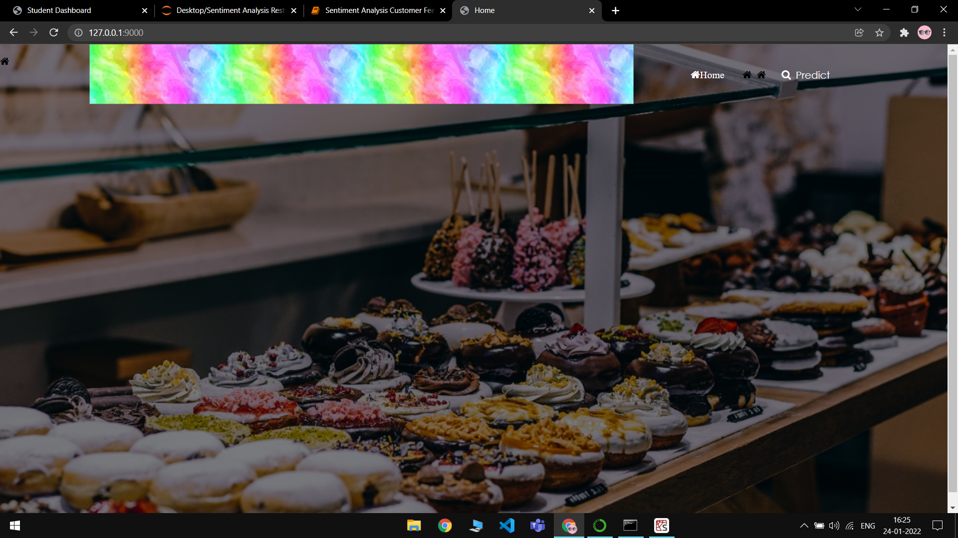

Slide 20
